Slide 1
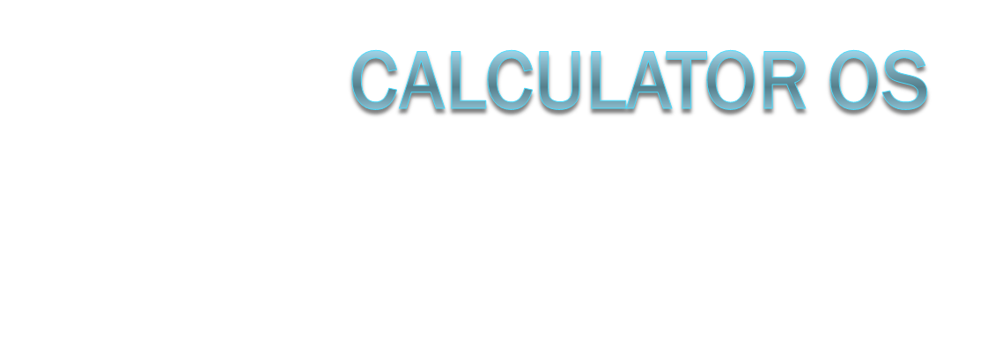
By Brian Cullinan
And Travis Hudson

Slide 2
Focus Areas
Grey-scale imaging
File Management
User Interfaces
GTD implementation or other user apps
TBasic
TVim

Slide 3
Background
This is one of the only devices we have in common
There has been support for developing on the calculator for a while
Assembly is a powerful language that is supported by the Z80 chip
Mirage OS is very popular but lacks some functionality

Slide 4
Goal
We plan to improve on features of the popular Mirage OS
Command line support
Easy file management and test editor
A scheduler on the TI-84 which has a clock, this will enable alerts from a GTD implementation
Improved form of calculator basic and API

Slide 5
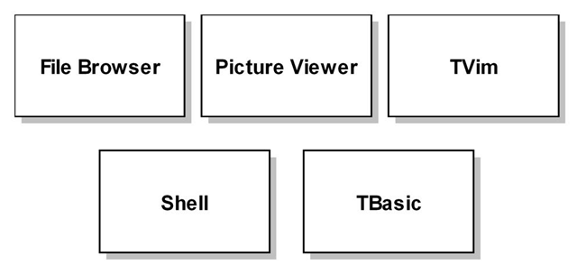
Technical Layout
Runs on top of the shell or compiled from TBasic
Compiled directly to processor code

Slide 6
Timeline
We will work in parallel to create Tbasic and a shell system
Then we will create a series of user applications such as a text editor and task reminders
We will conclude with a graphic conversion program that will allow displaying images on the calculator

